Slide 1

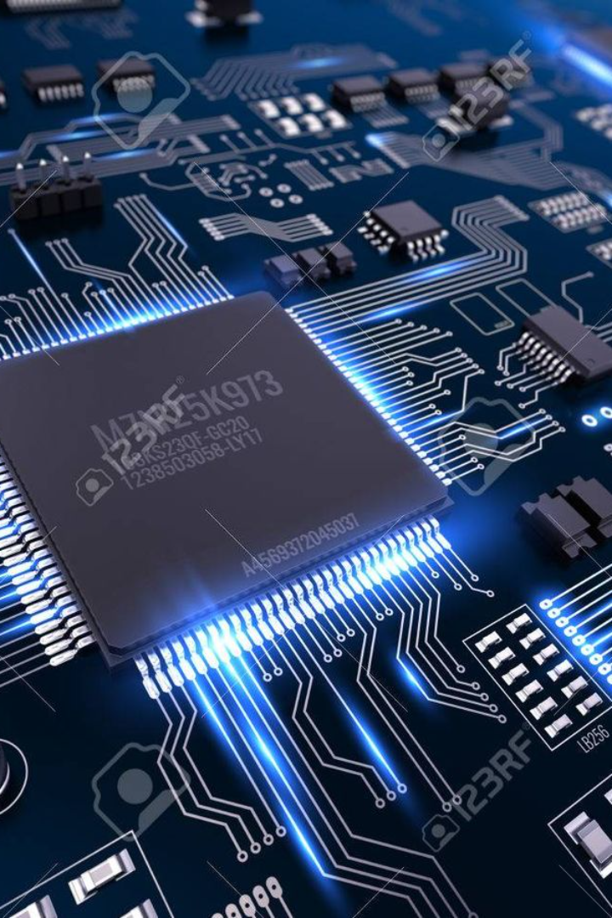
AQI Monitoring System over IOT using Raspberry Pi
1.Sojwal Kuthe
2.Sameer Bondhate
3.Harshay Dharade
4.Archit Khobragade

Slide 2
INTRODUCTION

Slide 3
The factors which are majorly responsible for air pollution are use of vehicles and industrialization.
The air pollution is a major concern for every individual in the society. As the air pollution increases, human faces many problems and health issues. The air pollution is also harmful to living things.

Slide 4
The air pollution is a major concern for every individual in the society. As the air pollution increases, human faces many problems and health issues. The air pollution is also harmful to living things.
Vehicles release lots of gaseous pollutants when we use them. These pollutants increase air pollution and these are harmful for human beings.
The factors which are majorly responsible for air pollution are use of vehicles and industrialization.

Slide 5
The air pollution is a major concern for every individual in the society. As the air pollution increases, human faces many problems and health issues. The air pollution is also harmful to living things.
The factors which are majorly responsible for air pollution are use of vehicles and industrialization.
Vehicles release lots of gaseous pollutants when we use them. These pollutants increase air pollution and these are harmful for human beings.
Industries leads to produce harmful gases which affects air pollution which is directly affecting the human health.

Slide 6
The air pollution is a major concern for every individual in the society. As the air pollution increases, human faces many problems and health issues. The air pollution is also harmful to living things.
The factors which are majorly responsible for air pollution are use of vehicles and industrialization.
Vehicles release lots of gaseous pollutants when we use them. These pollutants increase air pollution and these are harmful for human beings.
Industries leads to produce harmful gases which affects air pollution which is directly affecting the human health.
These harmful gaseous pollutants cause allergic reactions to humans, throat and nose infection, allergies leads to skin diseases

Slide 7
The air pollution is a major concern for every individual in the society. As the air pollution increases, human faces many problems and health issues. The air pollution is also harmful to living things.
The factors which are majorly responsible for air pollution are use of vehicles and industrialization.
Vehicles release lots of gaseous pollutants when we use them. These pollutants increase air pollution and these are harmful for human beings.
Industries leads to produce harmful gases which affects air pollution which is directly affecting the human health.
These harmful gaseous pollutants cause allergic reactions to humans, throat and nose infection, allergies leads to skin diseases

Slide 8

Importance of Monitoring Air Pollution
Public Health
Regulatory Compliance
Air pollution can have severe health impacts, including respiratory issues, breathing problem and cardiovascular problems.
Monitoring pollution levels is essential for ensuring compliance with environmental regulations and standards.
Environmental Impact
Pollution affects ecosystems, wildlife, and natural habitats, leading to biodiversity loss and ecological imbalance.

Slide 9
Public Health
Environmental Impact
Regulatory Compliance
Monitoring pollution levels is essential for ensuring compliance with environmental regulations and standards.
Air pollution can have severe health impacts, including respiratory issues, breathing problem and cardiovascular problems.
Pollution affects ecosystems, wildlife, and natural habitats, leading to biodiversity loss and ecological imbalance.

Slide 10
WHAT IS AQI?
An Air Quality Index (AQI) is a number used by government agencies to measure the air pollution levels and communicate it to the population. As the AQI increases, it means that a large percentage of the population will experience severe adverse health effects.
The measurement of the AQI requires an air monitor and an air pollutant concentration over a specified averaging period.
The results are grouped into ranges, and each range is assigned a descriptor, a color code and a standardized public health advisory

Slide 11
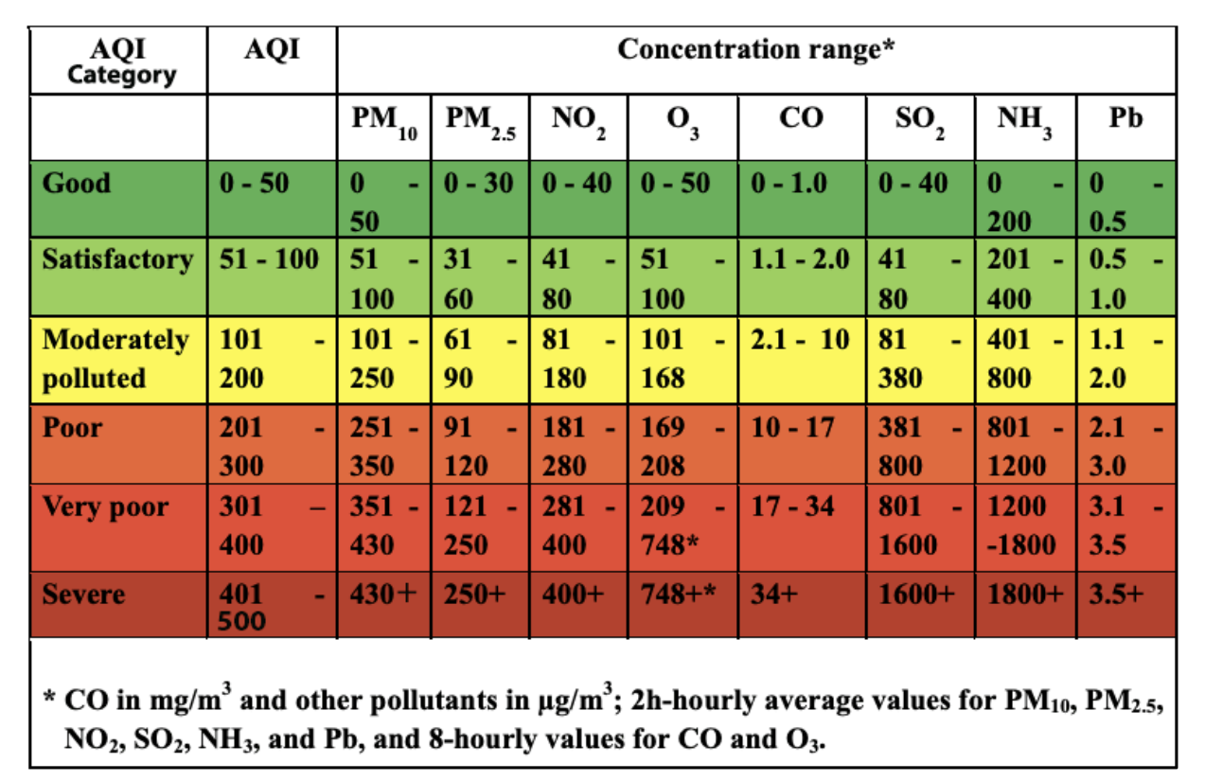

Slide 12
HOW AQI CALCULATED ?
The Sub-indices for individual pollutants at a monitoring location are calculated using its 24-hourly average concentration value (8-hourly in case of CO and O3) and health breakpoint concentration range. The worst sub-index is the AQI for that location.
All the eight pollutants may not be monitored at all the locations. Overall AQI is calculated only if data are available for minimum three pollutants out of which one should necessarily be either PM2.5 or PM10. Else, data are considered insufficient for calculating AQI. Similarly, a minimum of 16 hours’ data is considered necessary for calculating subindex.
A subindex is a linear function (two different yet related notions) of the concentration of pollutants.
Ip = [IHi – ILo / BPHi – BPLo] (Cp – BPLo) + Ilo
Where,
Ip = index of pollutant p
Cp = truncated concentration of pollutant p
BPHi = concentration breakpoint i.e. greater than or equal to Cp
BPLo = concentration breakpoint i.e. less than or equal to Cp
IHi = AQI value corresponding to BPHi
ILo = AQI value corresponding to BPLo

Slide 13
PROJECT OVERVIEW
A monitoring system which monitors air pollution and noise pollution with the help of raspberry pi based on Iot.
The system will collect real-time data from sensors, store it in a database, and provide a user-friendly web interface for monitoring and analysis
This project deals with monitoring of air pollution as well as air quality and noise pollution and alerting if it exceeds certain value.

Slide 14
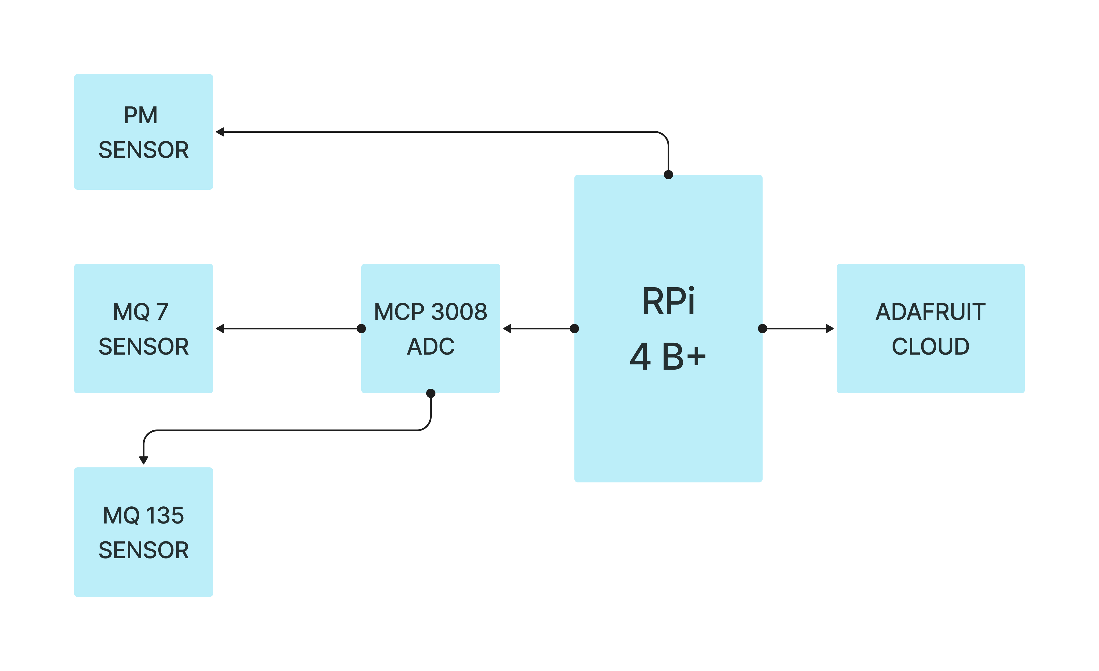
FLOW CHART

Slide 15
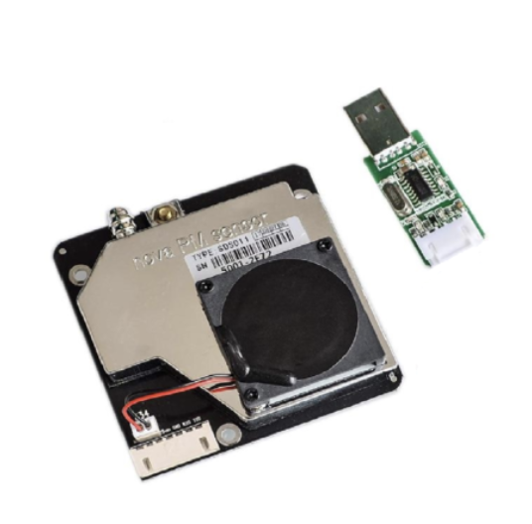
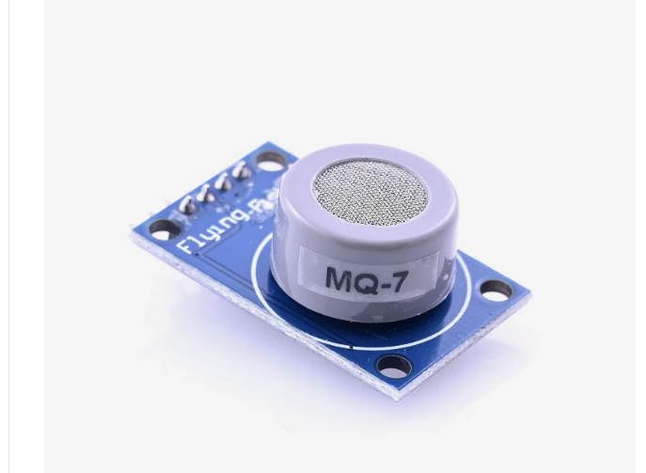
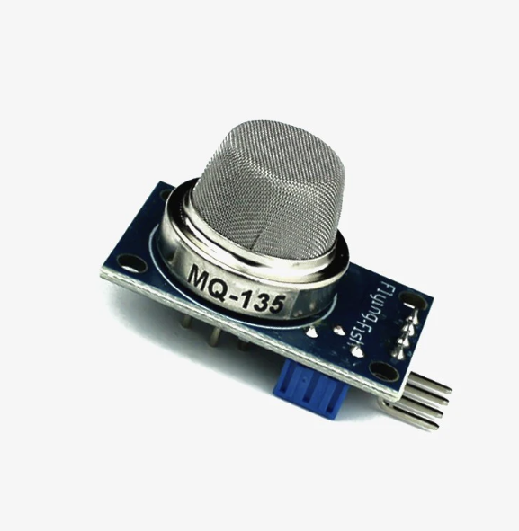
COMPONENTS AND THEIR DESCRIPTION
Nova PM Sensor SDS011
Provides high precision and reliable readings of PM2.5 and PM10 values. Response time is less than 10 seconds when the scene changes.Easy integration: UART output (or IO output can be customized), fan built-in.
MQ 7 - GAS SENSOR
Detects Carbon Monoxide.
Range 20 ppm to 2000 ppm.
Whenever CO gas comes into contact with the sensing element, the resistivity of the element changes. The change is then measured to get the concentration of the gases present.
CO concentration greater than 100 ppm is dangerous to humans
3) MQ 135 – GAS SENSOR
The MQ-135 Gas sensor can detect gases like Ammonia (NH3), sulfur (S), Benzene (C6H6), CO2, and other harmful gases and smoke.
This threshold value can be set by using the on-board potentiometer. The analog output pin, outputs an analog voltage which can be used to approximate the level of these gases in the atmosphere.
Here we are measuring NH3 (Ammonia)
PM SENSOR
Cost – 2600 RS
MQ - 7
Cost – 150 RS
MQ - 135
Cost – 150 RS

Slide 16
Components
Raspberry Pi (4B)
Nova PM Sensor SDS011
MQ 7 – CO gas detection sensor
MCP 3008 - 10-bit Analog-to-Digital Converter (ADC) for MQ 7
MQ 135 – NH3 gas detection sensor
MCP 3208 – 12-bit Analog-to-Digital Converter (ADC) for MQ 135
Resistors
HDMI cable
Male to Male , Male to female , female to female jumper wires
Breadboard
Total Cost: 7600 Rs (including raspberry pi)

Slide 17
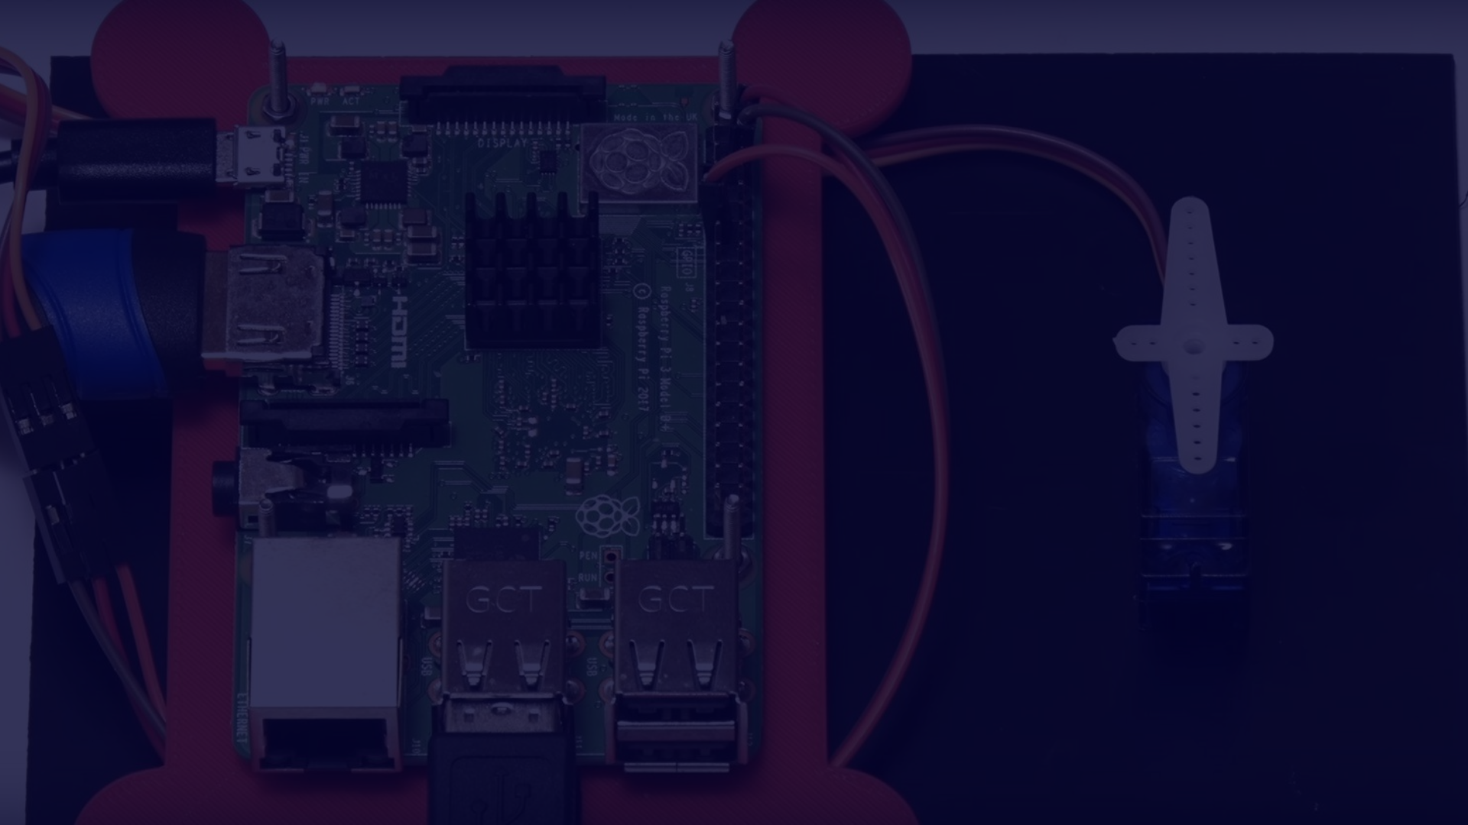



How the System Works
Data Collection
Data Processing
Remote Access
Environmental data is collected using sensors and transmitted to the Raspberry Pi board.
The collected data is processed and analyzed to generate meaningful insights and visualizations.
Users can access the data remotely through IoT connectivity for monitoring using IoT platform like thing speak.

Slide 18

Data Collection and Analysis
Real-time Monitoring
The system provides real-time updates on air quality and noise levels to the user using Iot platform and gives alert supporting immediate action.
Trend Analysis
Collected data allows for trend analysis, identifying patterns and changes over time for informed decision-making.
Data Visualization
Data collected can be visualized using graphs and charts provided by thing speak platform .Generated visualizations offer a clear representation of environmental data for easy interpretation.

Slide 19
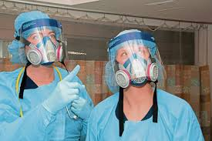
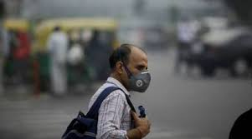
APPLICATIONS
Real-time Air Quality Monitoring:
Indoor Air Quality Monitoring:
Outdoor Air Quality Monitoring:.
Health Monitoring:
Alert Systems:.
Data Visualization and Analysis:

Slide 20

Conclusion and Future Developments
In conclusion, the Raspberry Pi Air and Noise Pollution Monitoring System over IoT project aims to address environmental concerns by creating a robust, cost-effective, and scalable solution. By utilizing the capabilities of the Raspberry Pi and IoT technologies, the project provides a comprehensive monitoring system that collects real-time data from sensors, stores it in a database, and presents it through a user-friendly web interface. Here are some key points to conclude the project:
Environmental Impact:
The project contributes to environmental awareness by monitoring air quality and noise pollution, providing valuable data for decision-making and public awareness.
Scalability and Flexibility:
The use of Raspberry Pi and IoT technologies allows for scalability, enabling the integration of additional sensors or the expansion of monitoring locations as needed.
Real-Time Monitoring:
The system offers real-time monitoring capabilities, allowing users to access up-to-the-minute data on air quality and noise levels.
Data Analysis and Visualization:
Data analysis features and visualization tools enhance the system's capabilities, helping users identify trends, patterns, and potential areas for improvement.
Alerting System (Optional):
The optional alerting system provides a proactive approach, notifying users when pollution levels exceed predefined thresholds, facilitating timely responses.

Slide 21
Future Developments
1
Ongoing Innovation
Continuous development to enhance monitoring accuracy and expand capabilities.
2
Integration with AI
Future plans to integrate artificial intelligence for advanced data analysis and predictive modeling.
3
Community Engagement
Focus on engaging communities in utilizing and benefiting from the monitoring technology.

Slide 22


SOJWAL KUTHE – 211020059
SOFTWARE SECTION - INSTALLED ALL THE NECESSARY LIBRARIES REQUIRED FOR CALCULATION OF AIR QUALITY INDEX
WRITTEN PYTHON SCRIPTS TO READ DATA FROM SENSORS .
ENSURED THAT THE DATA COLLECTED FROM SENSORS ARE IN CORRECT FORM AND HAS WRITTEN ALGORITHM FOR CALCULATING AQI, ALSO MADE CHANGES IN DATA OBTAINED AND TRANSOFED INTO FORM FOR IMPLEMENTING INTO AQI FORMULA , SET THE THRESHOLD FOR THE SENSORS AND RANGES TO SHOW WHETHER AQI CALCULATED IS SAFE FOR HUMANS
SAMEER BONDHATE – 211060065
DATA VISUALIZATION AND ANALYSIS – MANGED THE STORING OF DATA IN SYSTEMATIC FORM AND HANDLING THE ERRORS OBTAINS , ALSO THE ANALYSIS OF DATA BY MAKING DATA READILY AVAILABLE AFTER RUNNING THE SYSTEM.
MADE DATA UNDERSTANDABEL BY VISUALIZATION INTO GRAPHICAL FORMAT AND MADE DASHBOARD FOR LIVE MONITORING OF DATA . MADE NECCESARY CHANGES IN CODE TO SEND DATA TO REMOTE DEVICE .

Slide 23

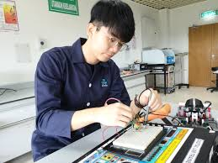
ARCHIT KHOBRAGADE – 211060015
COMPONENT SELECTION - DONE RESEARCH ON VARIOUS COMPONENTS REQUIRED AND NECESSARY FOR THE PROJECTS
ANALYZING WHETER GIVEN COMPONET CAN INTERFACE WITH OTHER COMPONETS AND WHICH ONES ARE CHEAPS ONES , WHICH CAN BE READILY AVAILABALE , AND WHICH PARAMETER ARE NECESSARY FOR MEASURING AQI AND WHICH SENSOR WE ARE GOING TO USE
HARDWARE PROCUREMENT - CHOOSING THE RIGHT HARDWARE COMPONENT , CHECKING THEIR PARAMETERS AND RANGE, DONE THE CALIBRATION AND TESTING OF THE OVERALL SENSOR AFTER MADE
HARSHAY DHARADE – 211060055
HARDWARE ASSEMBLY – DONE THE CONNECTION OF HARDWARE COMPONENTS AND SET UP ALL THE WIRING OF THE CIRCUITRY AND ENSURED THAT ALL COMPONETS ARE PROPERLY CONNECTED TOGETHER AND TESTED THE FUNCTIONING OF ALL THE COMPONETS
SET UP THE RASPBERRY PI AND FLASH THE RASPIAN OS INTO THE RASPBERRY PI.
SET UP RASPBERRY PI FOR PROGRAMMING

Slide 24

THANK YOU

Slide 25
THANK YOU

